Slide 1
Reverse Engineering University of Sheffield – 9th March 2022

Slide 2
Talk Overview
What is RE, what RE involves and why we do it
Prerequisite knowledge
Common tools and techniques
Platform-specific RE
Breaking the problem down
Example – Reverse Engineering with Ghidra
Developing RE skills
Career opportunities

Slide 3
Talk Overview
What is RE, what RE involves and why we do it
Prerequisite knowledge
Common tools and techniques
Platform-specific RE
Breaking the problem down
Example – Reverse Engineering with Ghidra
Developing RE skills
Career opportunities

Slide 4
What is Reverse Engineering?
Deconstructing something* and analysing its components (context, functionality, inputs and outputs) in order to truly understand how it works.
*software, firmware, hardware, system or process

Slide 5
What does that involve?
PART 0 - Google
PART 1 - Getting at the code
PART 2 - Analysing the code

Slide 6
PART 1 - Getting at the code
Searching for open-source code
E.g. in the Linux kernel
Looking for available firmware downloads
Reviewing any previous attempts
Rooting/jailbreaking a device and pulling off the firmware
Performing hardware teardowns to dump memory
Unpacking firmware once we have it
Locating binaries of interest within the firmware

Slide 7
PART 2 - Analysing the code
Reviewing any previous research
File hashes can be very useful
Static Analysis
Source code review
Disassembling and decompiling
Hopefully there’s a version with symbol information??
Binary analysis tools e.g. file, strings, readelf, ldd on Linux
‘grep’
Dynamic Analysis
Running the program to see what happens (if safe to do so)
Debugging
Emulation
Binary instrumentation
Custom tools development / scripting

Slide 8
Why do we do it?
Vulnerability Research
Proof of Concept Exploit Development
Malware Analysis
Research tool development
Sometimes we are just curious and want to develop our skills
For anyone who likes problem-solving, it’s a lot of fun

Slide 9
Talk Overview
What is RE, what RE involves and why we do it
Prerequisite knowledge
Common tools and techniques
Platform-specific RE
Breaking the problem down
Example – Reverse Engineering with Ghidra
Developing RE skills
Career opportunities

Slide 10
Prerequisite Knowledge
Understanding of relevant programming languages
Understanding of the architecture (ARM, x86, x64, MIPS)
Platform-specific knowledge:
Operating System internals
Chipset-specifics (e.g. Android boot process)
Getting on device (rooting, jailbreaking)
Tools and techniques (e.g. platform-specific debuggers)

Slide 11
Talk Overview
What is RE, what RE involves and why we do it
Prerequisite knowledge
Common tools and techniques
Platform-specific RE
Breaking the problem down
Example – Reverse Engineering with Ghidra
Developing RE skills
Career opportunities

Slide 12
Common Tools and Techniques
Disassemblers: IDA Pro and Ghidra
Decompilers: Hex-Rays, Ghidra, jadx-gui, JEB
Something to read/write code e.g. VS Code
Debuggers: IDA Pro, gdb, lldb
Instrumentation and hooking frameworks: Frida
Emulators: Ghidra, QEMU
Strings, Linux commands/scripting, PowerShell

Slide 13
Talk Overview
What is RE, what RE involves and why we do it
Prerequisite knowledge
Common tools and techniques
Platform-specific RE
Breaking the problem down
Example – Reverse Engineering with Ghidra
Developing RE skills
Career opportunities

Slide 14
Platform-specific RE
Android
adb, Android Studio, Frida, Java, C, vendor customisations, Android IPC, rooting and flashing (e.g. Magisk), ARM
iOS
lldb, libimobiledevice, Frida, Objective-C, Swift, entitlements, PAC, jailbreaks, ARM
Embedded Systems
UART, JTAG, MIPS, PowerPC, RTOS
Browsers
JavaScript, WebAssembly, JIT
Windows
Sysinternals, C#, x86/64

Slide 15
Talk Overview
What is RE, what RE involves and why we do it
Prerequisite knowledge
Common tools and techniques
Platform-specific RE
Breaking the problem down
Example – Reverse Engineering with Ghidra
Developing RE skills
Career opportunities

Slide 16

Breaking the problem down

Slide 17
Talk Overview
What is RE, what RE involves and why we do it
Prerequisite knowledge
Common tools and techniques
Platform-specific RE
Breaking the problem down
Example – Reverse Engineering with Ghidra
Developing RE skills
Career opportunities

Slide 18
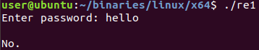
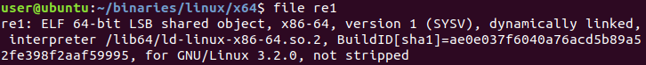
Reversing Engineering with Ghidra
Feb 2022: https://ringzer0.training/reverse-engineering-with-ghidra.html
To strip: gcc -s re1.c

Slide 19
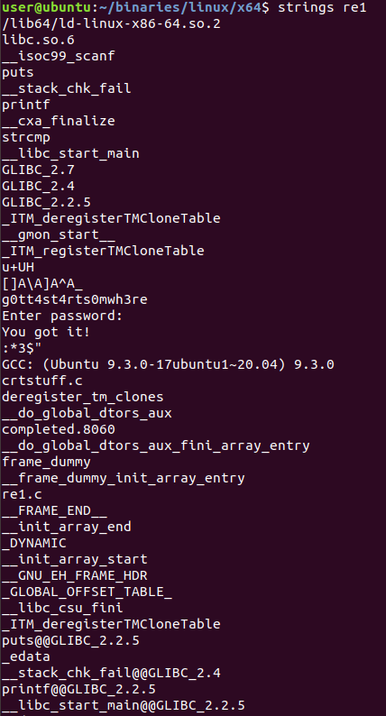
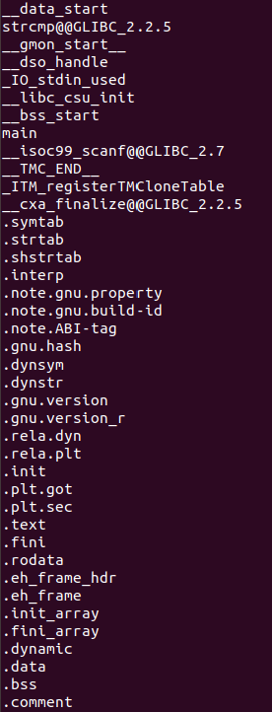
Reversing Engineering with Ghidra

Slide 20
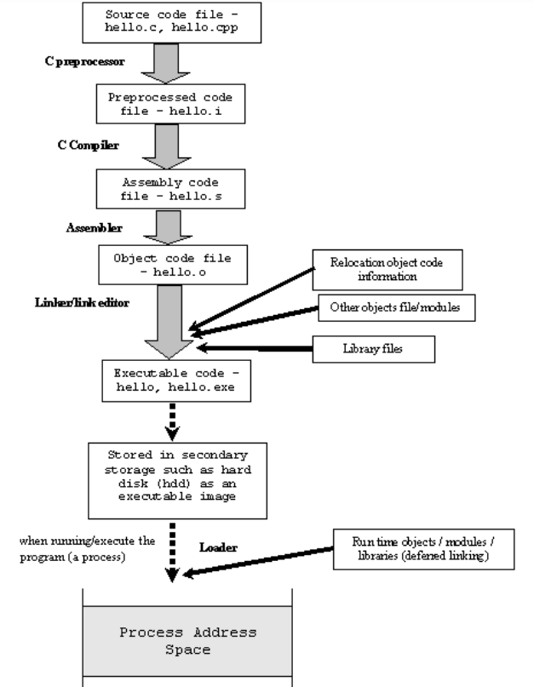
Decompiler (pseudocode)
Human- readable
Disassembler
Not human-readable from here downwards
https://rahul-saini.medium.com/machine-code-vs-byte-code-vs-object-code-vs-source-code-vs-assembly-code-812c9780f24c

Slide 21

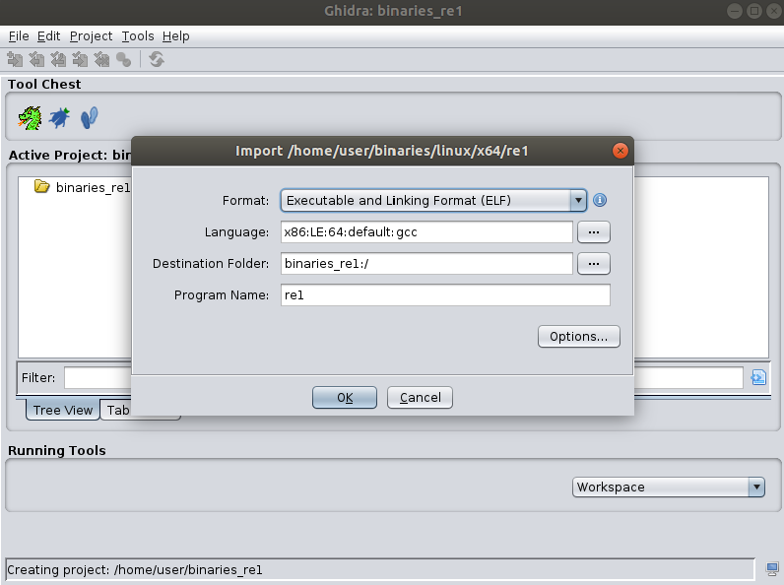
Ghidra – Re1

Slide 22
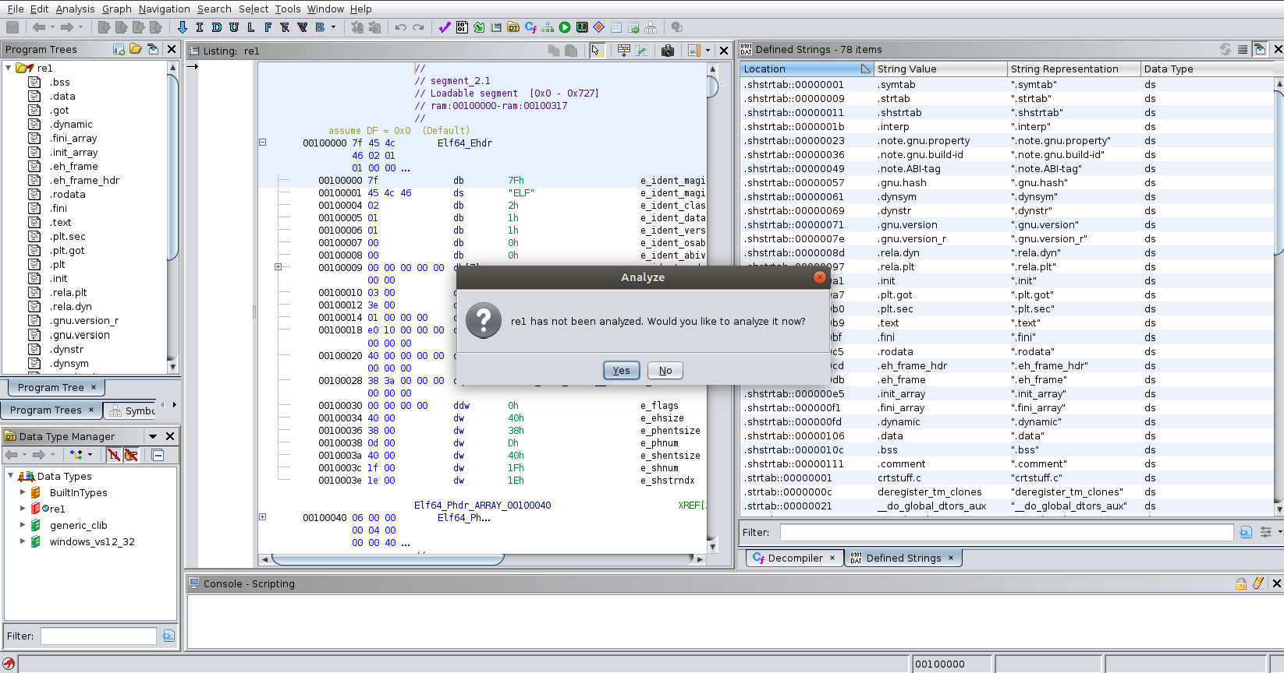

Slide 23
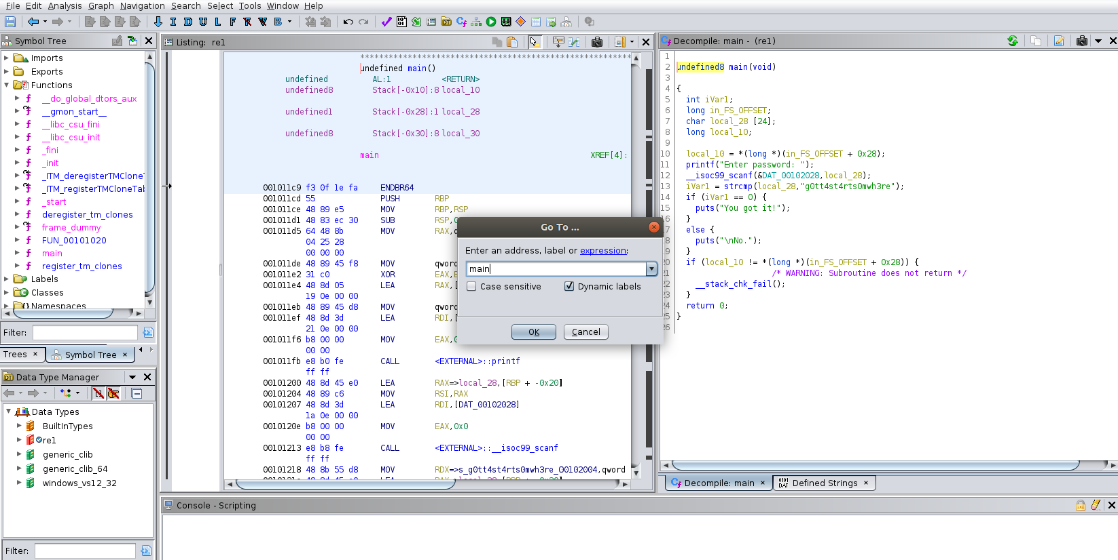

Slide 24
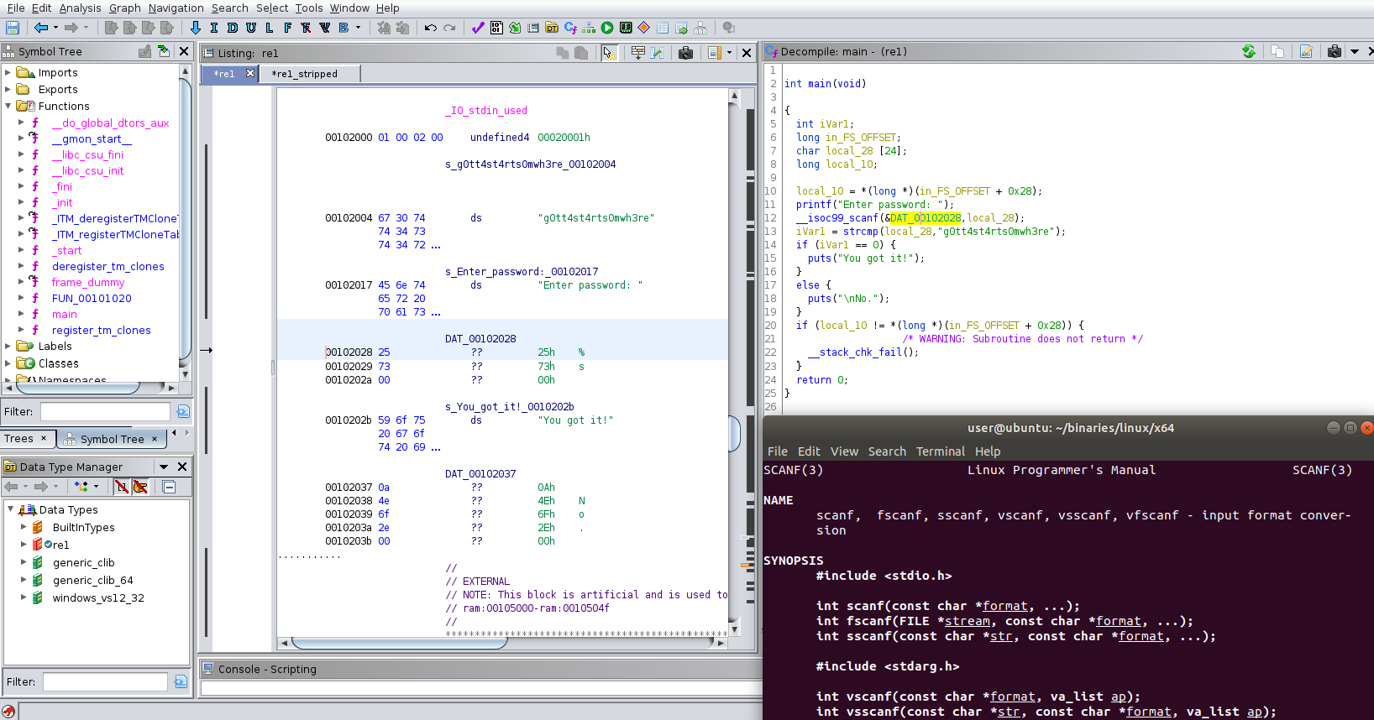

Slide 25
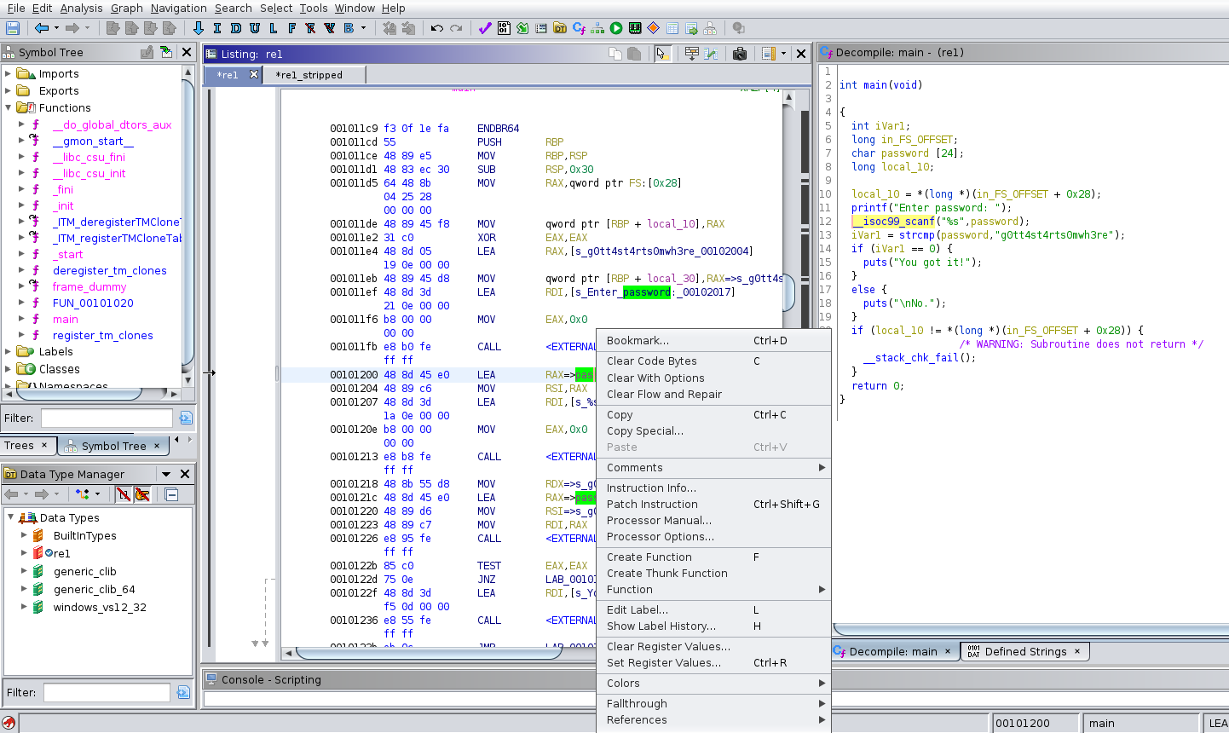

Slide 26
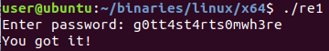

Slide 27
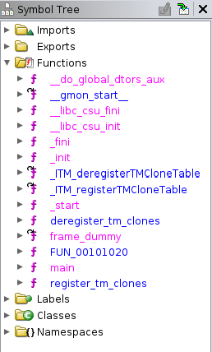
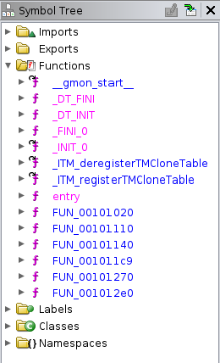
Stripped binary vs. non-stripped
Not stripped
Stripped

Slide 28
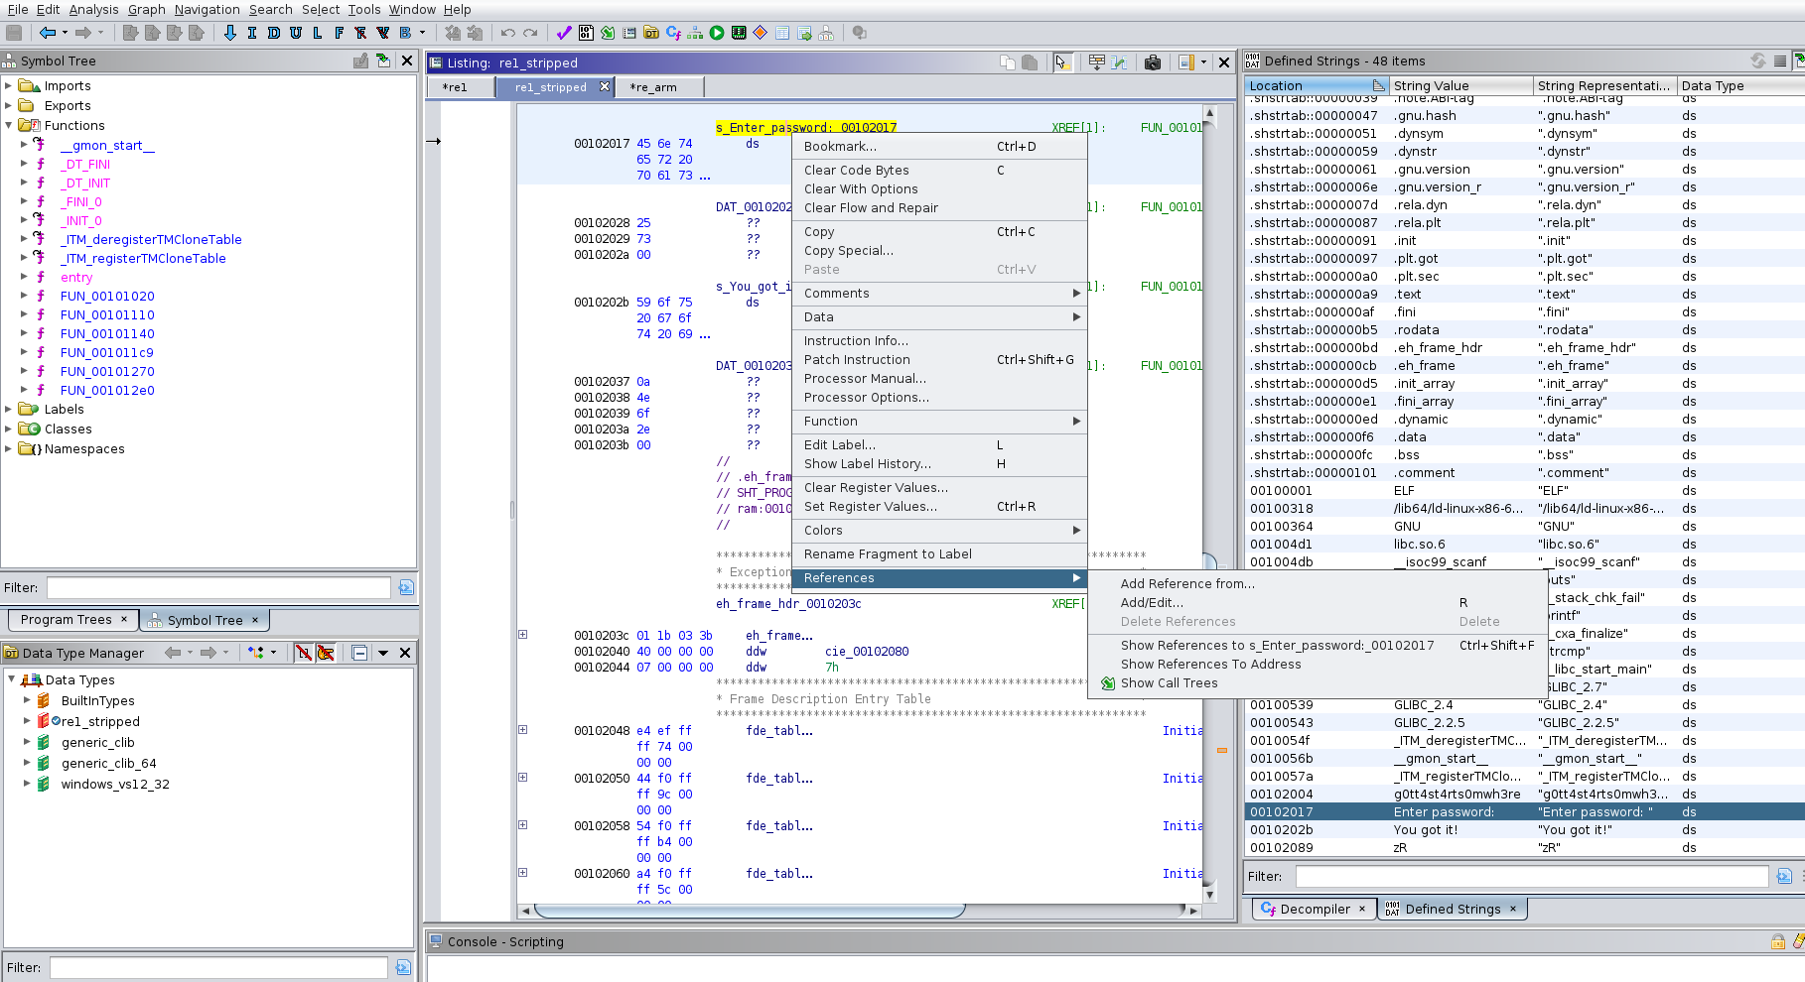
Working with a stripped binary

Slide 29
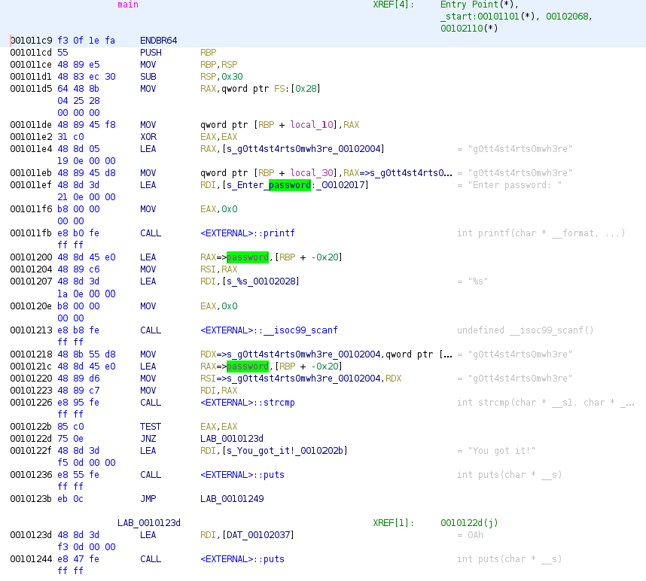
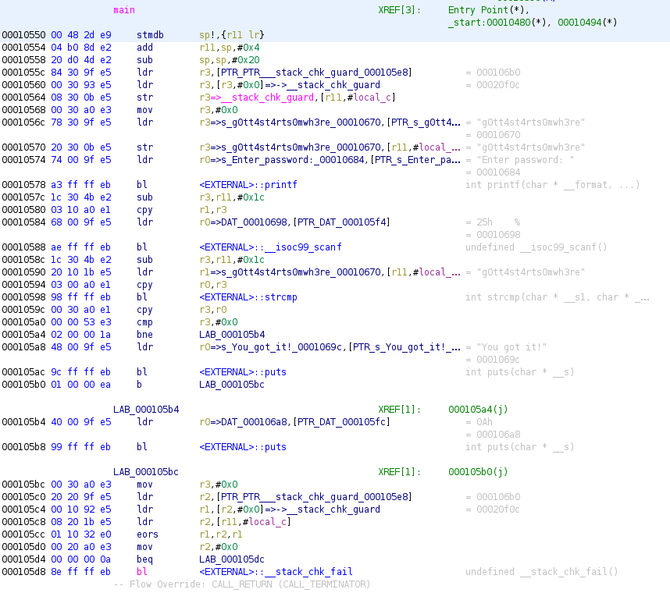
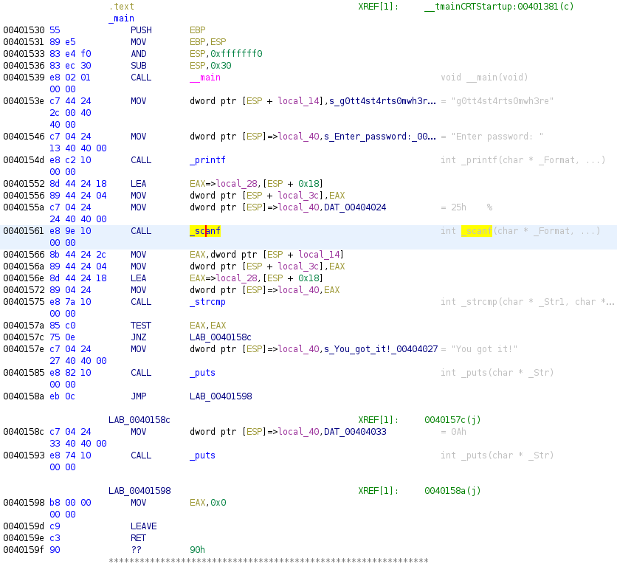
Reversing Engineering with Ghidra
Linux X86_64
Linux ARM
Windows x86

Slide 30
What makes RE hard?
Protections against static analysis
No symbols
Obfuscation
Packing / encryption / compression
Enormous binaries
Protections against dynamic analysis
Anti-debugging techniques
Anti-instrumentation techniques

Slide 31
Talk Overview
What is RE, what RE involves and why we do it
Prerequisite knowledge
Platform-specific RE
Common tools and techniques
Breaking the problem down
Example – Reverse Engineering with Ghidra
Developing RE skills
Career opportunities

Slide 32
Developing RE/VR skills (today)
Blog posts on challenge solutions
CTFs
https://ringzer0.training/reverse-engineering-with-ghidra.html
Tools: Ghidra, Frida etc.
Write a hello world, stripped vs. not stripped, compile and practice
Android App Reverse Engineering 101 (Maddie Stone) on YouTube
Azeria Labs (ARM and iOS)
Reach out to industry!

Slide 33
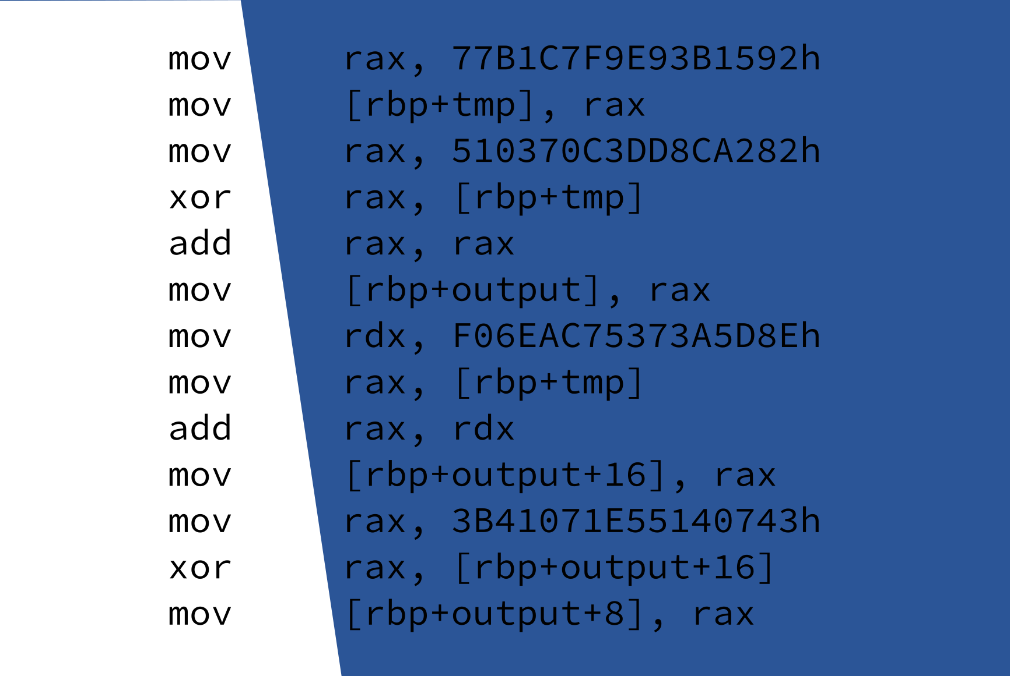
CHALLENGE

Slide 34
Talk Overview
What is RE, what RE involves and why we do it
Prerequisite knowledge
Platform-specific RE
Common tools and techniques
Breaking the problem down
Example – Reverse Engineering with Ghidra
Developing RE skills
Career opportunities

Slide 35
Career Opportunities at IL
Vulnerability Researcher Development Programme
Full-time position with 6 months RE and VR training
£30K (increasing to £35K after 6 months)
Requires eligibility for UK Government SC clearance
Associate Vulnerability Researcher
Full-time position in one of our research teams
£35K +
Locations: Basingstoke or Remote
Getting in touch:
https://interruptlabs.co.uk/careers/
vrdp@interruptlabs.co.uk
careers@interruptlabs.co.uk

